Slide 1
Data Storage and Indexing
Introduction to Data Storage

Slide 2

Objectives
Objective
Recognize major data storage layouts

Slide 3
The Memory Hierarchy
Example:
Intel PIII
CPU: 450MHz
Memory: 512MB
CPU Die
CPU
Registers
L1 Cache
40 ns
L2 Cache
90ns
Main Memory
14 ms = 14000000 ns
Hard Disk
Notes:
Cost is affected significantly by disk accesses !

Slide 4
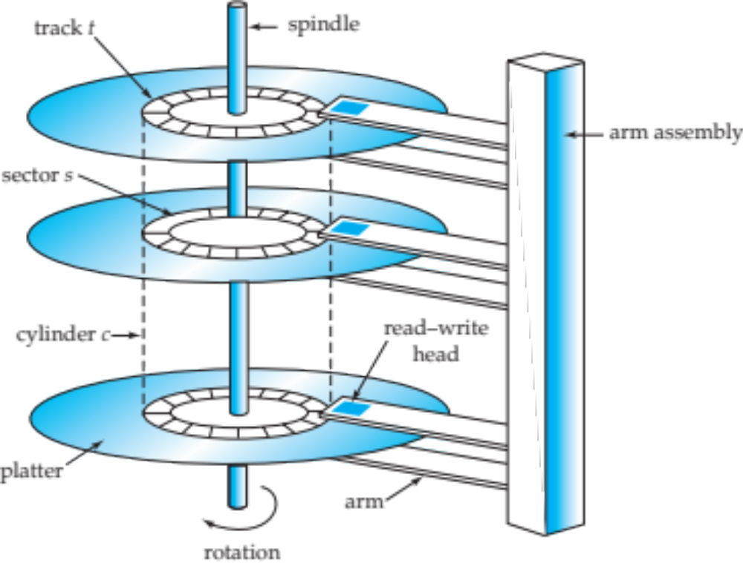
Internal Data Storage
Image source: https://www.snia.org
Notes:
The time for a disk block access, or disk page access or disk I/O
access time = seek time + rotational delay + transfer time

Slide 5


External Data Storage
Disks
  Can retrieve random page at fixed cost
    Reading several consecutive pages is much cheaper than reading them in random order
Tapes
  Can only read pages in sequence
    Cheaper than disks; used for archival storage

Slide 6
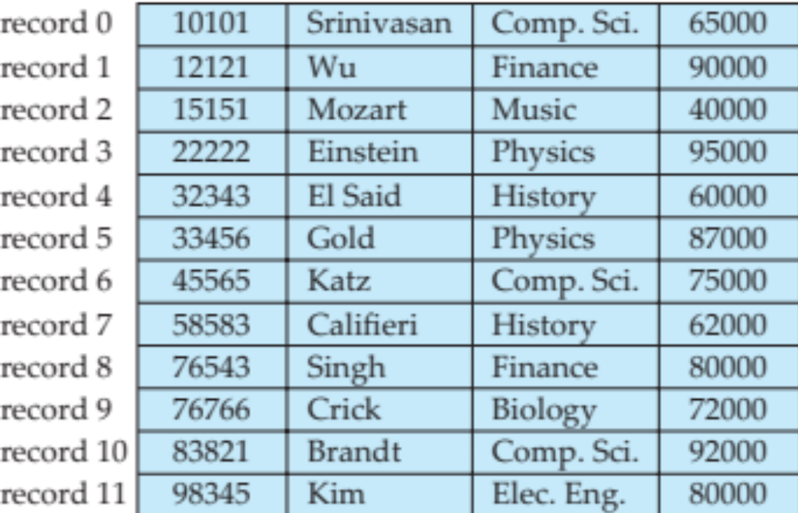
Data on External Storage
File
  a logical collection of data, physically stored as a set of pages
File Organization
  Method of arranging a file of records on external storage organized by Record ID(rid)
Notes:
Record ID (rid) is sufficient to physically locate record
Indexes are data structures that allow the location of the record ids of records with given values in index search key fields

Slide 7

Data on External Storage
Architecture
  Buffer manager stages pages from external storage to main memory buffer pool.
  File and index layers make calls to the buffer manager.

